Slide 1

Polyglot Persistence
#DECODEDConf
David Makogon, Microsoft
@dmakogon

Slide 2
Brain food…
The data landscape
Azure and data
The database types
Polyglot persistence

Slide 3
The Data Landscape

Slide 4
So much data!
90% of the world’s data has been created in the last two years….
George Lee. Chief Information Officer, Investment Banking Division, Goldman Sachs

Slide 5
Data growth
130 billion gigabytes in 2010
4.4 zettabytes* in 2013
IDC projections:
44 zettabytes by 2020
180 zettabytes by 2025
* 1 Zettabyte = 1 trillion gigabytes

Slide 6
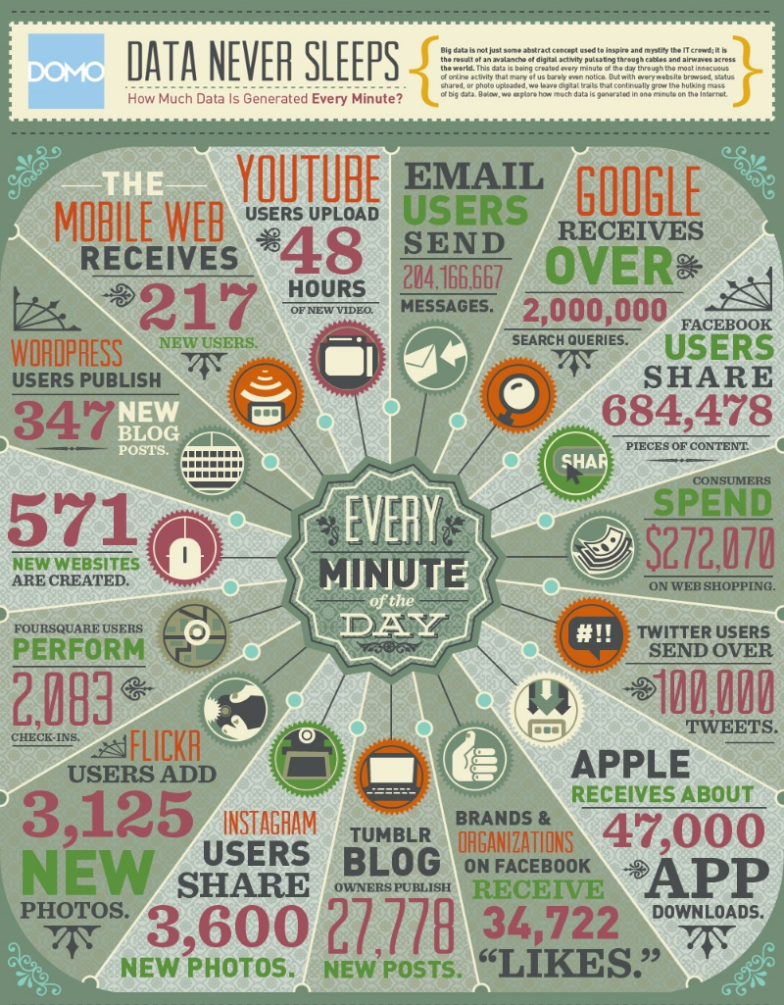
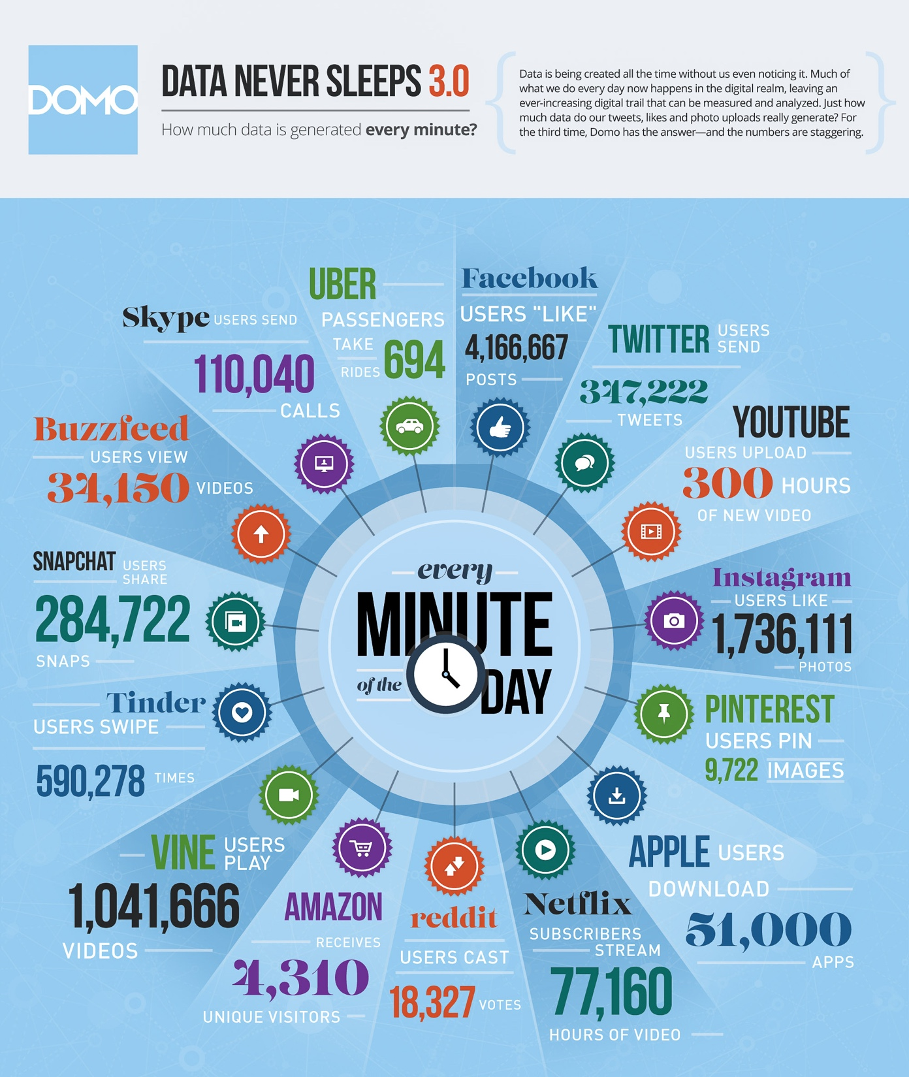
 | 2012 | 2015
YouTube | 48 hours | 300 hours
Twitter | 100,000 tweets | 347,000 tweets
Instagram | 3,600 shares | 1.7 million likes
Facebook | 684,000 shares | 4.1 million likes
Vine | Non-existent | 1 million views
Snapchat | Non-existent | 285,000 snaps
Tinder | Non-existent | 590,000 swipes
Data generated per minute:

Slide 7
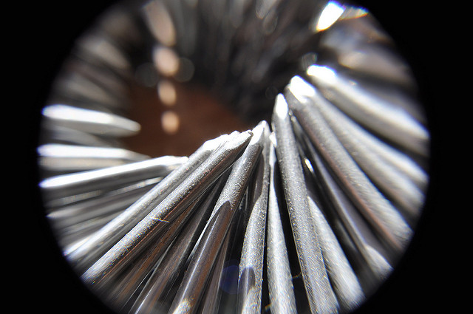
The shape of data
Golden Hammer anti-pattern:
When all you have
is a hammer…
Jennifer Boyer – “Nails" - https://flic.kr/p/7J9mJQ

Slide 8
Avoiding the Golden Hammer
NoSQL: It’s not just about Relational anymore
Multiple database categories and data shapes
Relational
Document
Key/Value
Graph
Column

Slide 9
Key/value databases

Slide 10
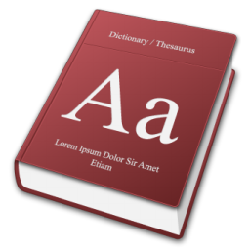
What’s a key/value store?
Effectively, this ->
You search for a Key to find an opaque value

Slide 11
Why use a Key/Value store?
Very rapid, discreet look-ups
When you always know the Key
When you only ever query by Key

Slide 12
Less optimal?
Searching on properties within the Value
Complex queries

Slide 13
Options in Azure?
PaaS
Azure Table Storage
Redis Cache service
IaaS
Redis
Riak
Memcached
And so many more ….

Slide 14
Demo – key/value database

Slide 15
Document databases

Slide 16
What’s a document database?
NOT for this kind of document !

Slide 17
What’s a document database?
{
“id": “13244_user",
"firstName": "John",
"lastName": "Smith",
"age": 25,
"address":
{
"streetAddress": "21 2nd Str",
"city": "New York",
"state": "NY",
"postalCode": "10021"
},
“mobileNumber": "212 555-1234"
}
For this kind of document -

Slide 18
Developer Appeal
Promotes code first development
Resilient to iterative schema changes
Richer query and indexing (compared to KV stores)
Low impedance as object / JSON store; no ORM required
I
developers

Slide 19
Use Cases and Applicability
Mobile and Web
User data store
IoT scenarios
Event workflow and logging
Data ingestion and presentation
Product catalogs

Slide 20
Less optimal use
Complex relational data
Complex map/reduce aggregations
Distributed transactions
OLAP

Slide 21
Options in Azure?
PaaS
Azure DocumentDB
mLab, MongoDB, Compose
RavenHQ
Iaas
MongoDB
CouchDB
Couchbase
ArangoDB
And countless more …

Slide 22
Example query: DocumentDB
SELECT * FROM f WHERE f.id = "AndersonFamily"
var query = from f in client.CreateDocumentQuery<Family>(collectionLink)
where f.Id == "AndersonFamily"
select f;

Slide 23
Demo – document datatabase

Slide 24
Graph databases

Slide 25
What’s a graph database?
Nodes and relationships
And properties
And all the query stuff

Slide 26

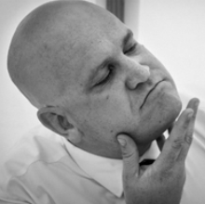

What’s a graph database?
Maybe I should see that movie…
I reviewed that movie!
Reviewed
Friends with

Slide 27
Why a graph database?
Ideal for complex connections
Easy navigation between things (nodes)
No need for complex joins
Easy to add to, and evolve, existing model

Slide 28
Why a graph database?
Less-than-optimal:
Complex relational data
OLAP

Slide 29
Options in Azure?
PaaS
Graph Story
GrapheneDB
IaaS
Neo4j
Dex
OrientDB
InfiniteGraph
AllegroGraph
And many more!

Slide 30
Example query: Neo4j
(ryan:Person)-[:FRIENDS_WITH]->(david:Person)
-[:REVIEWED]->(movie:Movie {Title:’Fletch’})

Slide 31
Demo – graph database

Slide 32
Column databases

Slide 33
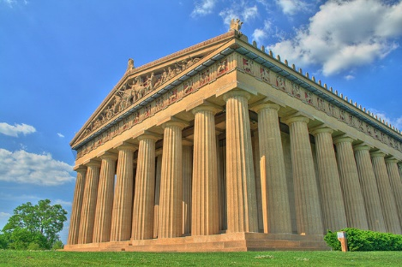
Column stores
Not these columns:
Will Powell – “Nashville Parthenon – HDR” - https://flic.kr/p/2k8TxH

Slide 34
What’s a column store?
Data is keyed by row (e.g. Twitter ID)
Individual content stored as columns
Groups of columns comprise a column family

Slide 35
Example: Weather data
Data is keyed by row (e.g. weather station ID)
Columns may have standard or custom names
For weather: Each col name = date
stationID | Timestamp temp | Timestamp temp | Timestamp temp | …
stationID | Timestamp temp | Timestamp temp | Timestamp temp | …

Slide 36
Why a column family? Why not?
Optimal:
Very large quantities of data
Queries well-known up-front
Scale and durability
Non-optimal:
Highly-relational data
Querying on many different properties

Slide 37
Options in Azure?
IaaS
Cassandra
HBase

Slide 38
Using Cassandra + CQL
CREATE TABLE temperature (
stationID text,
readingtime timestamp,
temp text,
PRIMARY KEY (stationID,readingtime)
);
INSERT INTO temperature(stationID,readingtime,temp)
VALUES (‘1’,’2015-02-23 09:00:00′,’45F’);

Slide 39
Finding temperatures
SELECT readingtime,temp
FROM temperature
WHERE stationID=’1’;

Slide 40
Polyglot persistence

Slide 41
Choices, choices, choices!
Relational
Key/value
Graph
Column
Document
Ready… set… CHOOSE!
Hmmm… Not so easy, eh?

Slide 42
Why so difficult to pick one?
Schema enforcement
Reporting
Interconnections
Time-series
Rapid lookup
Scale-out
Scale-up
Durability

Slide 43
Compromises when picking just one database
Referential integrity & transactions
Schema flexibility
Scale
Reporting
Skillsets
HA/DR procedures
3rd-party tools and the ecosystem

Slide 44
Do we have to compromise?
Combine!
Why not?
Maybe… a bit of each?

Slide 45



Imagine… a shopping site
E-Commerce platform
Cart
Orders
Catalog & Reviews
Suggestions
Key/value
RDBMS
Document
Graph
Notes:
Don't forget to think about telemetry/logging of the shopping site's web server. Maybe… a column store?

Slide 46
Challenges?
Multiple DB skillsets
More complex HA/DR/Backup procedures
Additional licensing and support
Determining System(s) of Record

Slide 47
Challenges challenged
What’s the effort and cost for?
Avoiding the Golden Hammer
INSERT INTO ROUND_HOLE
VALUES (‘SQUARE_PEG’)

Slide 48
Benefits
Use each database type for its strengths
Reduce scope and complexity with a database type

Slide 49
Questions?
Keep in touch!
Twitter: @dmakogon
Blog: dmak.io
Materials at github.com/dmakogon/decodedconf2016

Slide 50
Notes:
Dark gray background.

